Slide 1
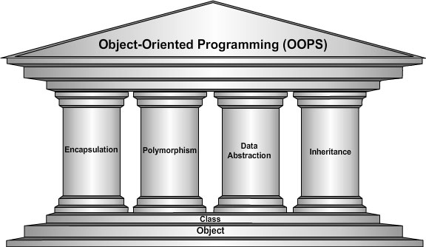
COMP 53 – Week Two
Operator Overloading

Slide 2
Topics
Basic Operator Overloading
Unary operators
As member functions
References and More Overloading
<< and >>
Operators: = , [], ++, --

Slide 3

Why Do We Care
Simplify coding syntax
Ability to use similar operations on abstract data types
Polymorphism is key building block of Object Oriented Programming

Slide 4
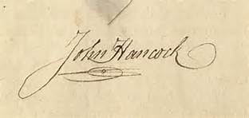

Function Overloading Array Sum Example
Function Signature
Data types
Number of Parameters
Overloading
Same function name
But different signature
Constructors work in same way
Integer Version
int sumarray(int a[], int size) {
int sum = 0;
for (int i = 0; i < size; i++)
sum += a[i];
return(sum); }
Double Version
double sumarray(double a[], int size) {
double sum = 0;
for (int i = 0; i < size; i++)
sum += a[i];
return(sum); }
Main Call
Double total, scores[3] = {1.0, 2.5, 3.5};
Int amount, values[3] = {5, 10 , 15};
Total = sumarray(scores, 3);
Amount = sumarray(values, 3);
Same function name, but different data types

Slide 5
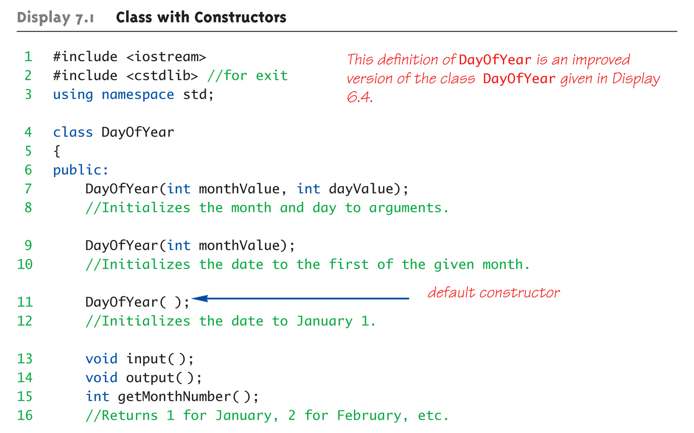
Class Constructors Overload Review
Note the different versions of constructor

Slide 6
Operator Overloading Introduction
What is a Math operation? Say x + 7 =
Syntax details
Binary operation (+, -, *, /, ==)
Unary operation (leading – or !)
What does an add function look like?
result = add(x, 7);
Could this be written like this? +(x, 7)
"+" is the function name
x, 7 are the arguments
Function "+" returns "sum" of it’s arguments
Notes:
Simply "called" with different syntax: x + 7
"+" is binary operator with x & 7 as operands
We "like" this notation as humans

Slide 7
Overloading Basics
Overloading operators
VERY similar to overloading functions
Operator itself is "name" of function
Work with OUR data types
Operator overload definitions generally very simple
Just perform "addition" particular to "your" type
Example Declaration: const Money operator +( const Money& amount1, const Money& amount2);
Overloads + for operands of type Money
Uses constant reference parameters for efficiency
Returned value is type Money
Allows addition of "Money" objects
Note keyword
Notes:
Given previous example:
Note: overloaded "+" NOT member function
Definition is "more involved" than simple "add"
Requires issues of money type addition
Must handle negative/positive values

Slide 8
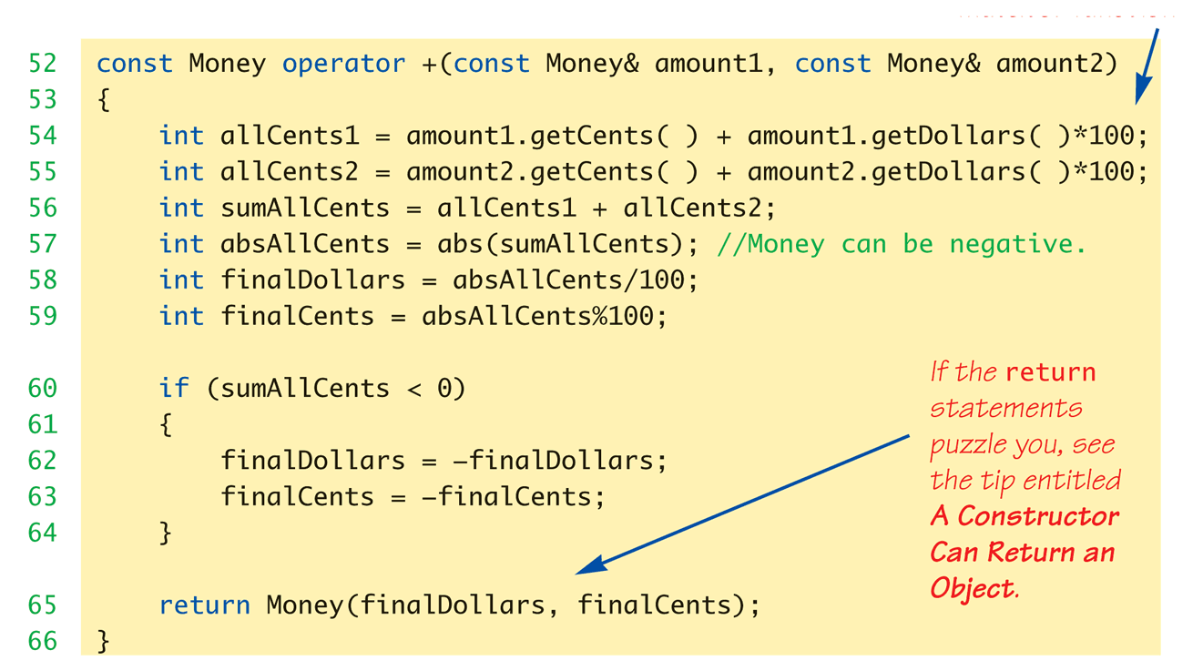
Money "+" Definition: Display 8.1 Operator Overloading
Note – function defined outside of class
Notes:
Previous examples: standalone functions
Defined outside a class
Can overload as "member operator"
Considered "member function" like others
When operator is member function:
Only ONE parameter, not two!
Calling object serves as 1st parameter

Slide 9
Constructors Returning Objects
Constructor a "void" function?
We "think" that way, but no
A "special" function
With special properties
CAN return a value!
Recall return statement in "+" overload for Money type:
return Money(finalDollars, finalCents);
Returns an "invocation" of Money class!
So constructor actually "returns" an object!
Called an "anonymous object"

Slide 10
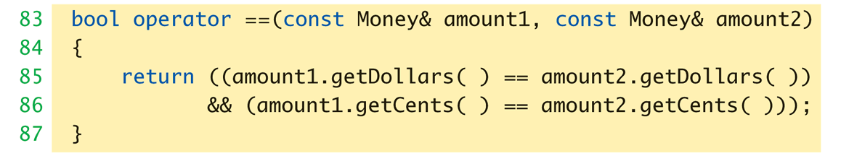
Overloaded "=="
Equality operator, ==
Enables comparison of Money objects
Declaration: bool operator ==(const Money& amount1, const Money& amount2);
Returns bool type for true/false equality
Again, it’s a non-member function (like "+" overload)

Slide 11
Need for const Return Value
Consider expression
newM = m1 + m2
Where m1 & m2 are Money objects
Object returned is Money object - which is assigned to newM
Objects have methods, so these can be invoked in any expression
(m1+m2).output(); //Legal
(m1+m2).input(); //ILLEGAL
Allows modification of "anonymous" object!
Can’t allow that here!

Slide 12
const Functions
When to make function const?
Constant functions not allowed to alter class member data
Constant objects can ONLY call constant member functions
Good style dictates:
Any member function that will NOT modify data should be made const
Use keyword const after function declaration and heading

Slide 13
Overloading Unary Operators
C++ has unary operators:
Defined as taking one operand
e.g., - (negation)
x = -y; // Sets x equal to negative of y
Other unary operators:
++, --
Unary operators can also be overloaded

Slide 14
Overload "-" for Money
Overloaded "-" function declaration
Place outside class definition
Single input parameter
"-" operator is overloaded twice!
For two operands/arguments (binary)
For one operand/argument (unary)
Definitions must exist for both
Overloaded "-" function definition:
Money operator –(Money& amount) { return Money(
-amount.getDollars(), -amount.getCents()); }

Slide 15
Overloaded "-" Examples
Money amount1(10), amount2(6), amount3; amount3 = amount1 – amount2;
amount3.output(); //Displays $4.00 amount3 = -amount1;
amount3.output() //Displays -$10.00
Binary overload
Unary overload

Slide 16
Operator Overload Practice
Create a project for DayOfYear class
Overload the + operator to add two dates together
Make sure to handle the cases of date wrap
If month > 12, need to subtract 12
If day > 30, need to subtract 30
Or use the modulus operator
Copy and paste the code in the notes section
Notice there are some commented out lines that should be used once you get the operator function created.
Notes:
#include <iostream>
#include <cstdlib> //for exit
using namespace std;
class DayOfYear
{
public:
DayOfYear(int monthValue, int dayValue);
//Initializes the month and day to arguments.
DayOfYear(int monthValue);
//Initializes the date to the first of the given month.
DayOfYear();
//Initializes the date to January 1.
void input();
void output();
int getMonthNumber();
//Returns 1 for January, 2 for February, etc.
int getDay();
private:
int month;
int day;
void testDate();
};
int main()
{
DayOfYear date1(2, 21), date2(5), date3;
cout << "Initialized dates:\n";
date1.output(); cout << endl;
date2.output(); cout << endl;
date3.output(); cout << endl;
// date3 = date1 + date2;
// cout << "Added date 3 = \n";
// date3.output(); cout << endl;
date1 = DayOfYear(10, 31);
cout << "date1 reset to the following:\n";
date1.output(); cout << endl;
system("pause");
return 0;
}
DayOfYear::DayOfYear(int monthValue, int dayValue)
: month(monthValue), day(dayValue)
{
testDate();
}
DayOfYear::DayOfYear(int monthValue) : month(monthValue), day(1)
{
testDate();
}
DayOfYear::DayOfYear() : month(1), day(1)
{/*Body intentionally empty.*/
}
//uses iostream and cstdlib:
void DayOfYear::testDate()
{
if ((month < 1) || (month > 12))
{
cout << "Illegal month value!\n";
system("pause");
exit(1);
}
if ((day < 1) || (day > 31))
{
cout << "Illegal day value!\n";
system("pause");
exit(1);
}
}
int DayOfYear::getMonthNumber()
{
return month;
}
int DayOfYear::getDay()
{
return day;
}
//Uses iostream and cstdlib:
void DayOfYear::input()
{
cout << "Enter the month as a number: ";
cin >> month;
cout << "Enter the day of the month: ";
cin >> day;
if ((month < 1) || (month > 12) || (day < 1) || (day > 31))
{
cout << "Illegal date! Program aborted.\n";
system("pause");
exit(1);
}
}
void DayOfYear::output()
{
switch (month)
{
case 1:
cout << "January "; break;
case 2:
cout << "February "; break;
case 3:
cout << "March "; break;
case 4:
cout << "April "; break;
case 5:
cout << "May "; break;
case 6:
cout << "June "; break;
case 7:
cout << "July "; break;
case 8:
cout << "August "; break;
case 9:
cout << "September "; break;
case 10:
cout << "October "; break;
case 11:
cout << "November "; break;
case 12:
cout << "December "; break;
default:
cout << "Error in DayOfYear::output. Contact software vendor.";
}
cout << day;
}

Slide 17
Member Operator in Action
Money cost(1, 50), tax(0, 15), total; total = cost + tax;
If "+" overloaded as member operator:
Variable/object cost is calling object
Object tax is single argument
Think of as: total = cost.+(tax);
Declaration of "+" in class definition:
const Money operator +(const Money& amount);
Notice only ONE argument

Slide 18
Overloading Operators: Which Method?
Object-Oriented-Programming
Principles suggest member operators
Many agree, to maintain "spirit" of OOP
Member operators more efficient
No need to call accessor & mutator functions
At least one significant disadvantage
(Later in chapter…)

Slide 19
Overloading >> and <<
Enables input and output of our objects
Improves readability
Enables:
cout << myObject; cin >> myObject;
Instead of need for: myObject.output(); …

Slide 20
What really is cout/cin
Both are defined as objects inside of <iostream>
The << and >> symbols are binary operands
Need to define return values for << and >> operations
Example: cout << "Hello";
Operand 1 is the object
Operand 2 is a string constant
Notes:
Recall Money class
Used member function output()
Nicer if we can use >> operator: Money amount(100); cout << "I have " << amount << endl; instead of: cout << "I have "; amount.output()

Slide 21
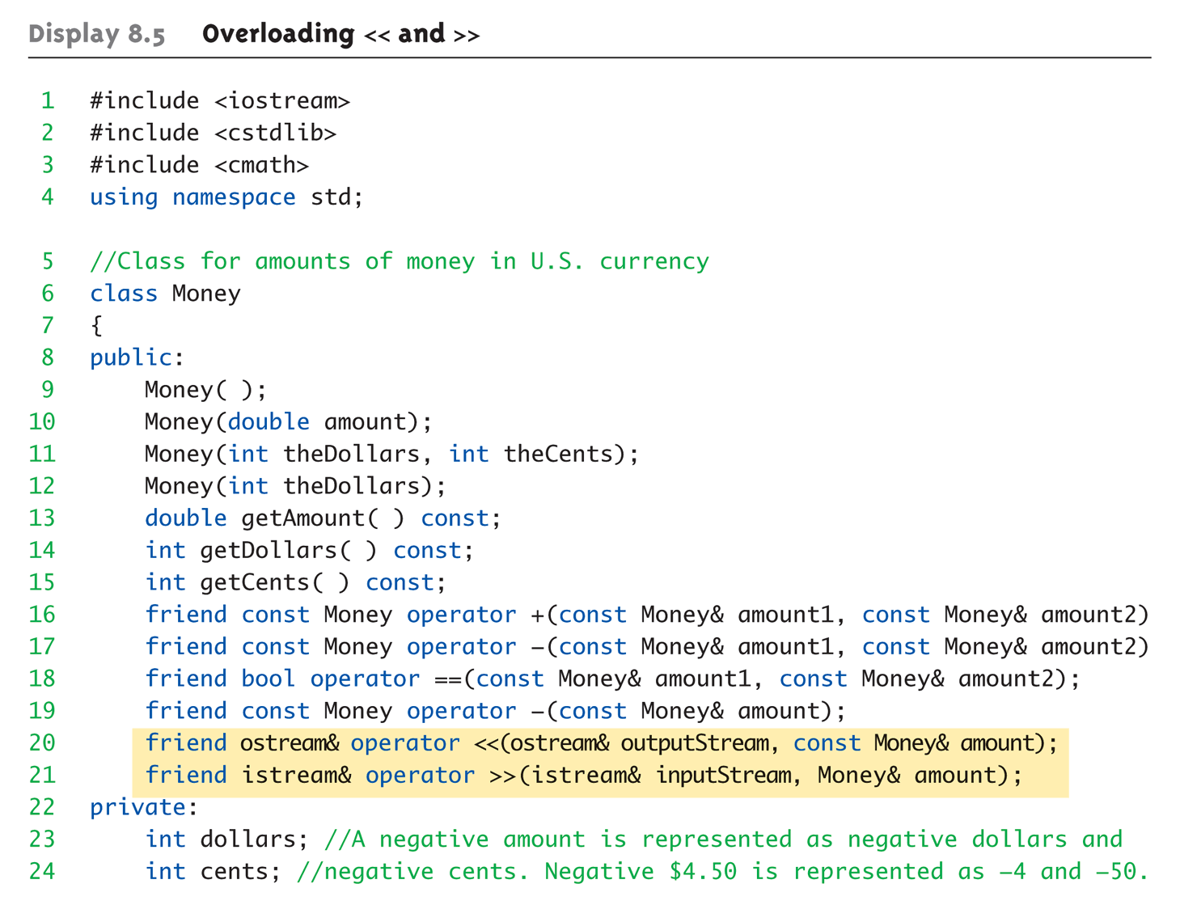
Overloaded >> Example 1 of 5

Slide 22
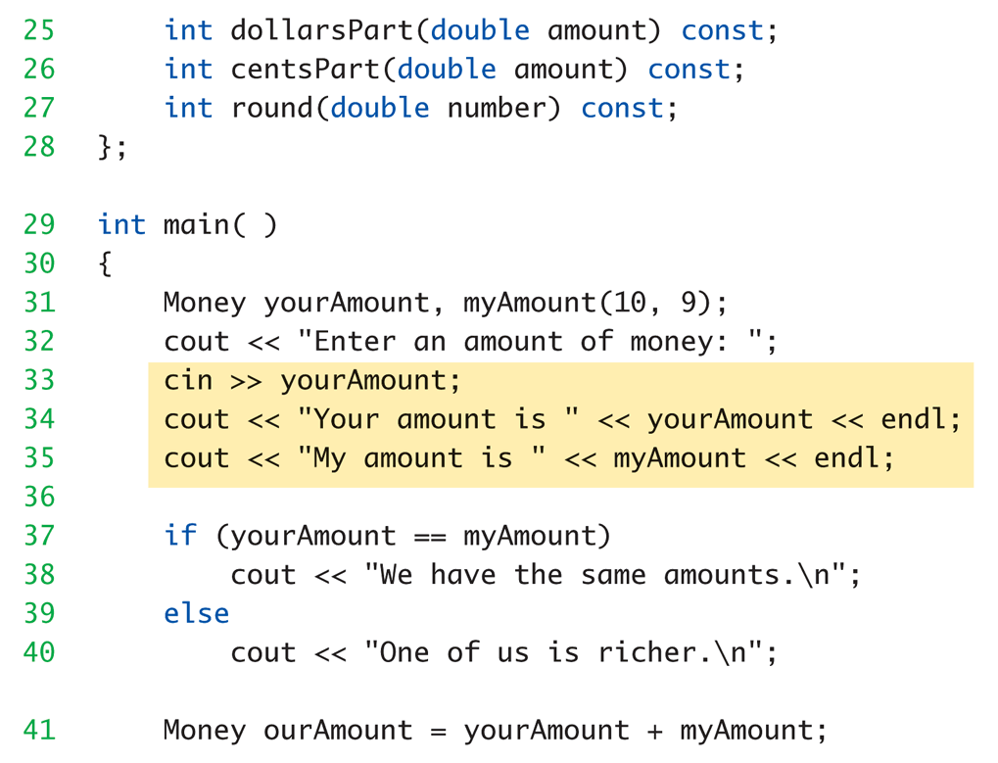
Overloaded >> Example 2 of 5

Slide 23
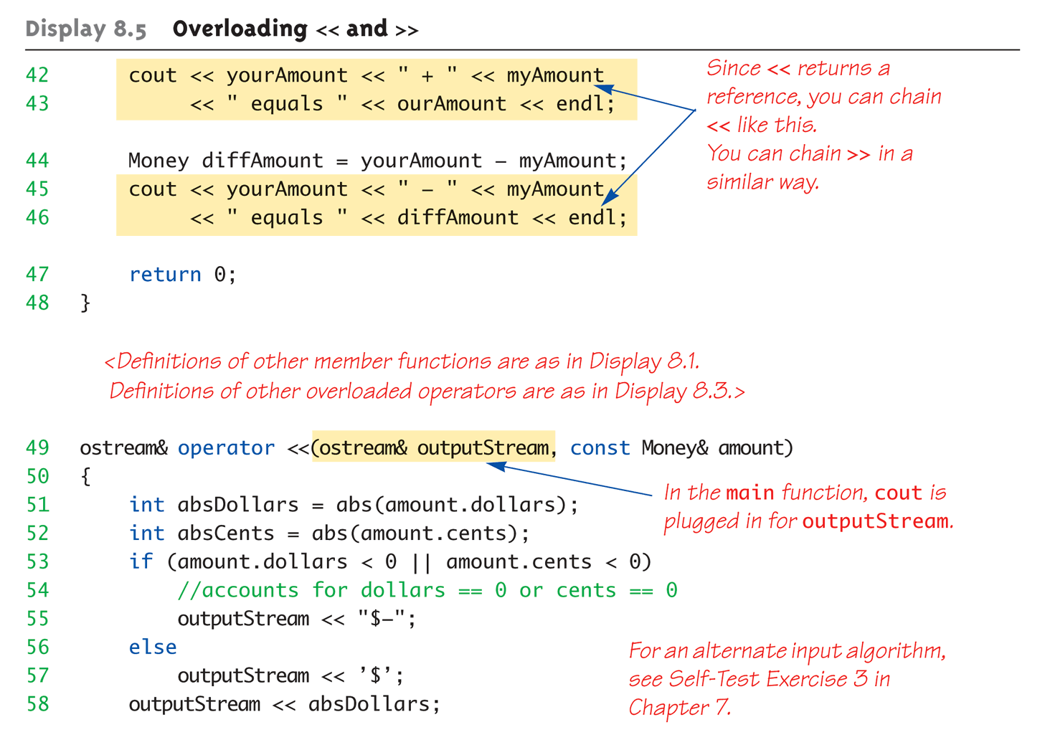
Overloaded >> Example 3 of 5

Slide 24
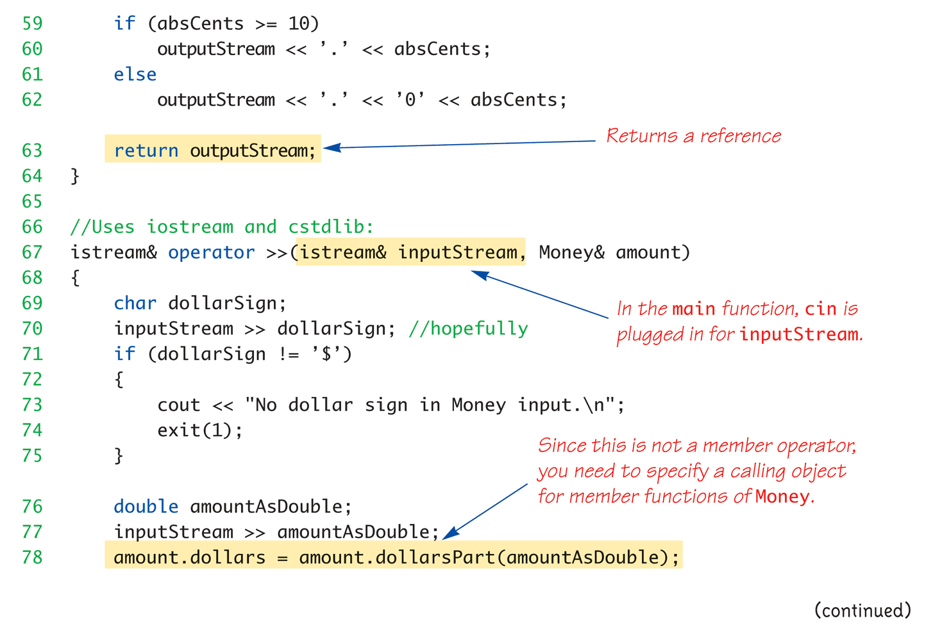
Overloaded >> Example 4 of 5

Slide 25
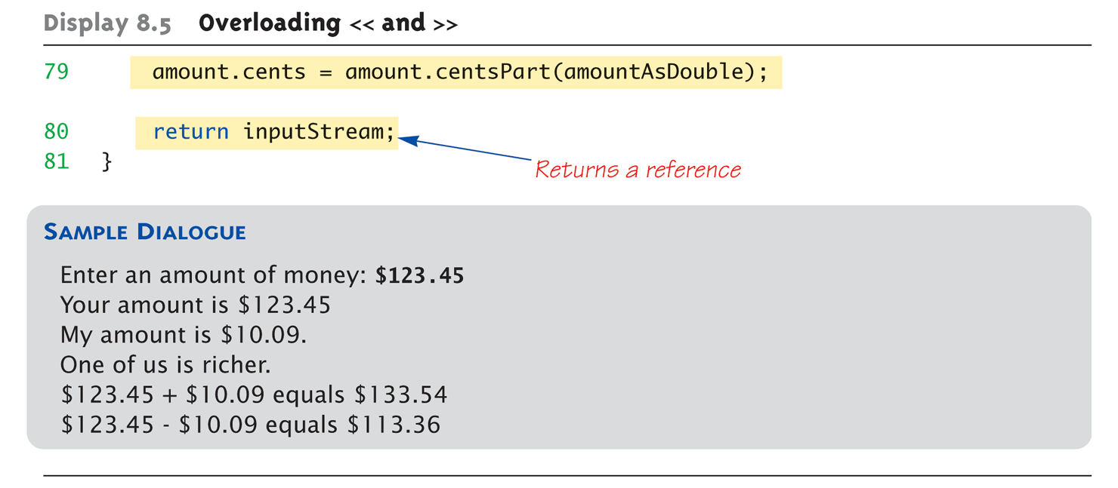
Overloaded >> Example 5 of 5

Slide 26
Assignment Operator, =
Must be overloaded as member operator
Automatically overloaded
Default assignment operator:
Member-wise copy
Member variables from one object → corresponding member variables from other
Default OK for simple classes
But with pointers → must write our own!

Slide 27
Increment and Decrement
Each operator has two versions
Prefix notation: ++x;
Postfix notation: x++;
Must distinguish in overload
Prefix – use operator ++(object) { … }
Postfix - use operator ++(object1, object1) { … }
Just a marker for compiler!
Specifies postfix is allowed

Slide 28
Increment Overload Practice
Add the increment ++ code to the Date project.
Add one to the months value
Make sure to check for going beyond 12 months.

Slide 29
Overload Array Operator, [ ]
Can overload [ ] for your class
To be used with objects of your class
Operator must return a reference!
Operator [ ] must be a member function!

Slide 30
Key Takeaways
Overloading is just ONE aspect of polymorphism
Operators are really just functions
C++ built-in operators can be overloaded
To work with objects of your class
Can overload <<, >>
Return type is a reference to stream type

